Slide 1

RESEARCH AND DEVELOPMENT OF HETEROJUNCTION BASED PHOTODETECTOR
MID SEMESTER EVALUATION
Molecular and Nanoelectronics Research Group
Department of Electrical Engineering
Indian Institute of Technology Indore
Supervised by
Dr. Vipul Singh
Professor, IIT Indore
Presented by
Anand Nivrutti Kachale
M.S. Research, IIT Indore

Slide 2
OUTLINE
Motivation
Introduction
Objective
Proposed work
ZnO Nanostructure growth
SEM and UV-Vis. result analysis
LSPR and Ag NPs deposition mechanism
Ag NPs deposition
SEM and UV-Vis. result analysis
COMSOL simulation for PVT
Conclusion
Plan of action
Acknowledgements
References

Slide 3
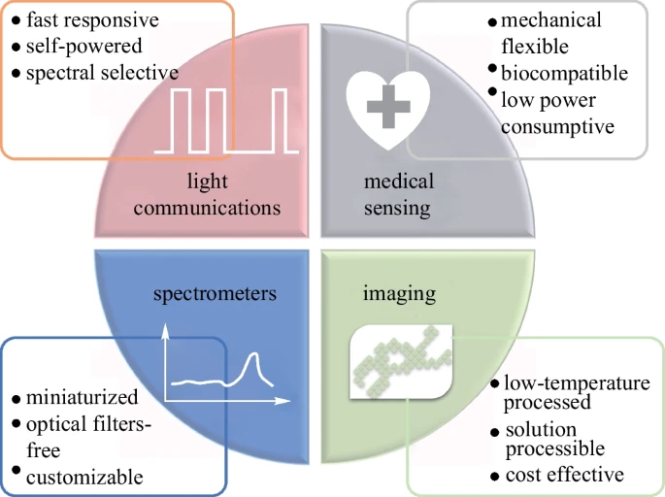
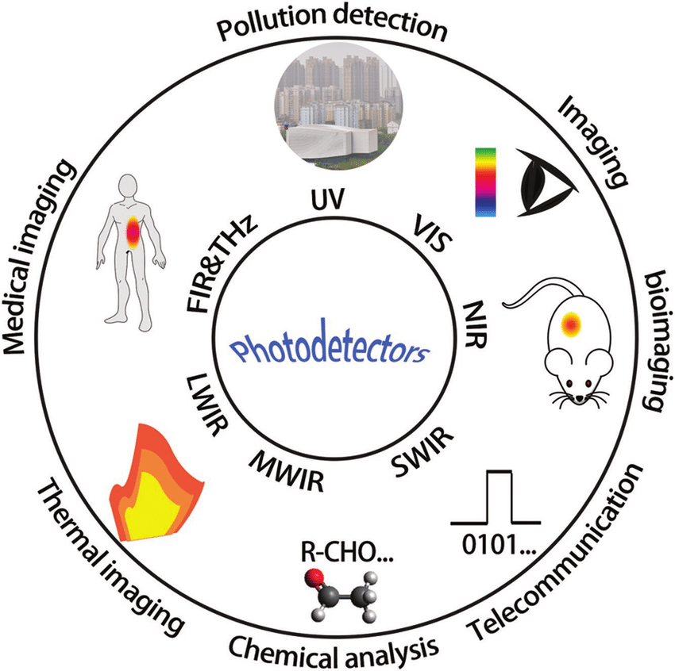
MOTIVATION
Increase in demand of photodetectors
[2]
[1]

Slide 4
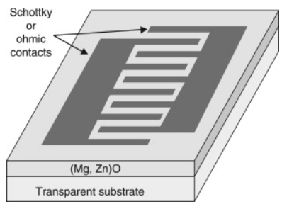
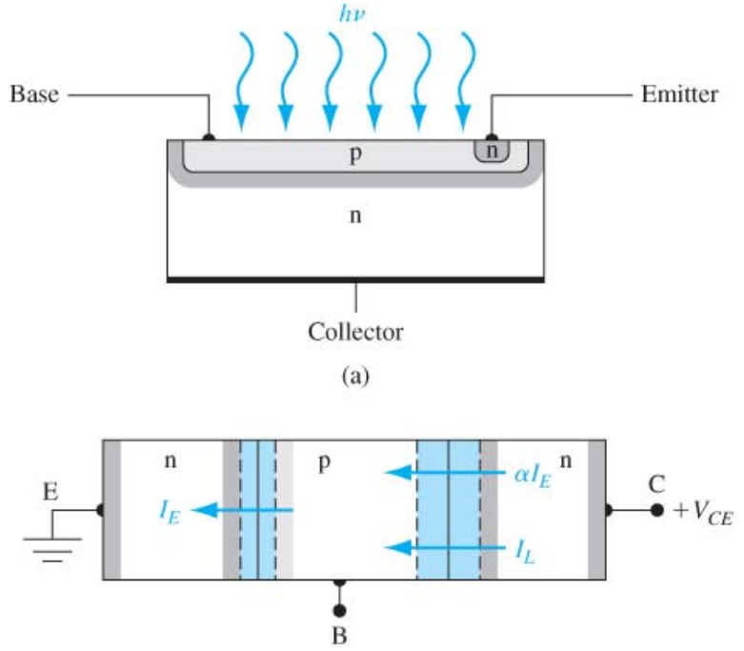
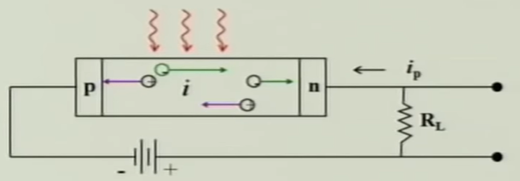
INTRODUCTION
PHOTODETECTORS
Photoconductor
Photodiode
Phototransistor
[3]
[4]
[5]

Slide 5
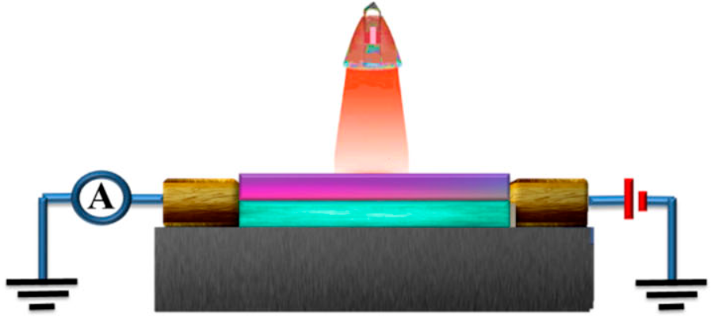
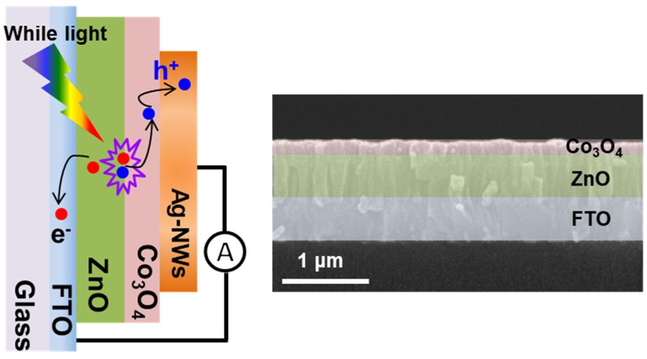
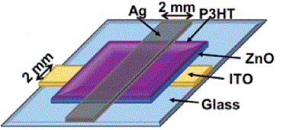

HETEROJUNCTION TYPES
Organic - Organic
Inorganic - Inorganic
Organic - Inorganic (Hybrid)
Phthalocyanine/C₆₀
ZnO/Co₃O₄
ZnO/P3HT
[8]
[10]
C₆₀
[9]

Slide 6
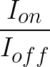
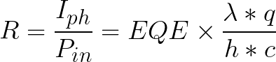
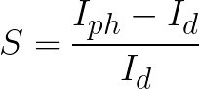
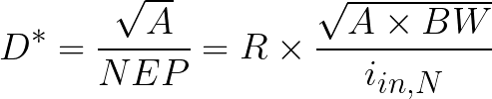
DEVICE PARAMETERS
Metric | Definition | Unit
Rectification ratio |  | --
Responsivity (R) |  | AW⁻¹
Photosensitivity (S) |  | --
Specific Detectivity (D*) |  | Jones
[8]
[9]

Slide 7
OBJECTIVES
Fabrication of heterojunction photodetector using solution process.
Optimization of various parameters to obtain crystalline growth of ZnO nanorods.
Study effect of UV-irradiation time and AgNO₃:Ethanol conc. on Ag particle size deposited.
To study physical vapor transport technique and perform simulation to get optimized parameters.
Fabrication of heterojunction photodetector using physical vapor transport technique.

Slide 8
NANOSTRUCTURE GROWTH
ZnO Seed solution 3M
Annealing at 240⁰ for 5 mins
ZnO Nanorods growth
Hydrothermal growth for 0-10mM KMnO₄ for 3hrs
Spin coating @ 3000rpm for 30 sec
ZnO Nanorods
ZnO Seed layer
Glass

Slide 9
NANOSTRUCTURE GROWTH
Pristine
0.5mM KMnO₄
1mM KMnO₄
5mM KMnO₄
10mM KMnO₄
Hydrothermal growth
ZnNO₃+HMTA
SEM
Characterization
3M ZnO Seed
UV-Vis.
Characterization

Slide 10
SEM RESULTS
Pristine
0.5mM
1mM
5mM
10mM
1mM
Inverted

Slide 11
UV-VIS RESULTS
Sample Details | Bandgap (eV)
Pristine | 3.29
0.5mM KMnO4 | 3.27
1mM KMnO4 | 3.26
10mM KMnO4 | 3.2

Slide 12
PCR (PHOTO CHEMICAL REDUCTION)
AgNO3 solution
Ethanol solution
Drop casted the prepared solution on the nanostructure
Preparation of AgNO3 : Ethanol solution of various concentrations
Rinse in DI
Ag NP deposited ZnO Nanorods
Black box
UV irradiation for 5 sec

Slide 13
Localized Surface Plasmonic Resonance
LSPR effect
Ag NPs deposition mechanism
Incident radiation
e⁻ e⁻
Ag Nuclei
Ag NPs
e⁻
UV irradiation
LSPR
[15]
Ag
Ag
e⁻ e⁻ e⁻
Ag⁺
Ag
ZnO
h⁺ h⁺ h⁺
CH₃CH₂OH
W
ZnO
ZnO
ZnO
CH₃CHO
AgO_{x}

Slide 14
Ag NP DEPOSITION
AgNO₃ : Ethanol
Additive
Hydrothermal growth
ZnNO₃+HMTA
0.5mM KMnO₄
1mM KMnO₄
1mM INV KMnO₄
No irradiation
1:9
1:4
3:7
UV irradiation for 5 sec
UV-Vis.
Characterization
3M ZnO Seed
SEM
Characterization

Slide 15
SEM RESULTS 0.5mM KMnO₄ with Ag NPs
No irradiation
1:9
AgNO3 : Ethanol
1:4
AgNO3 : Ethanol
3:7
AgNO3 : Ethanol

Slide 16

SEM RESULTS 1mM KMnO₄ with Ag NPs
No irradiation
1:9
AgNO3 : Ethanol
Increased diameter of ZnO nanorods
Increased growth rate of Ag NPs
1:4
AgNO3 : Ethanol
3:7
AgNO3 : Ethanol

Slide 17
UV-VIS RESULTS
0.5mM KMnO₄
1mM KMnO₄
Higher shift in resonant wavelength with higher conc. of AgNO₃

Slide 18
UV-VIS RESULTS
0.5mM KMnO₄
1mM KMnO₄
Higher shift in resonant wavelength with higher conc. of AgNO₃

Slide 19
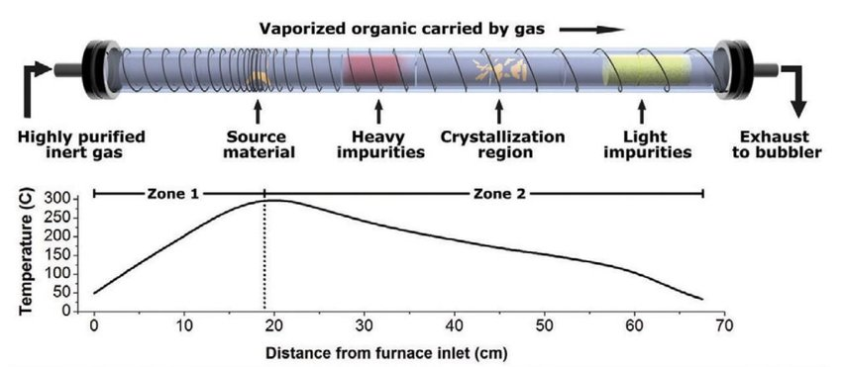
Physical Vapour Transport
PVT schematic
MULTIPHYSICS STUDY
Laminar flow
+
Heat transfer
[12]

Slide 20
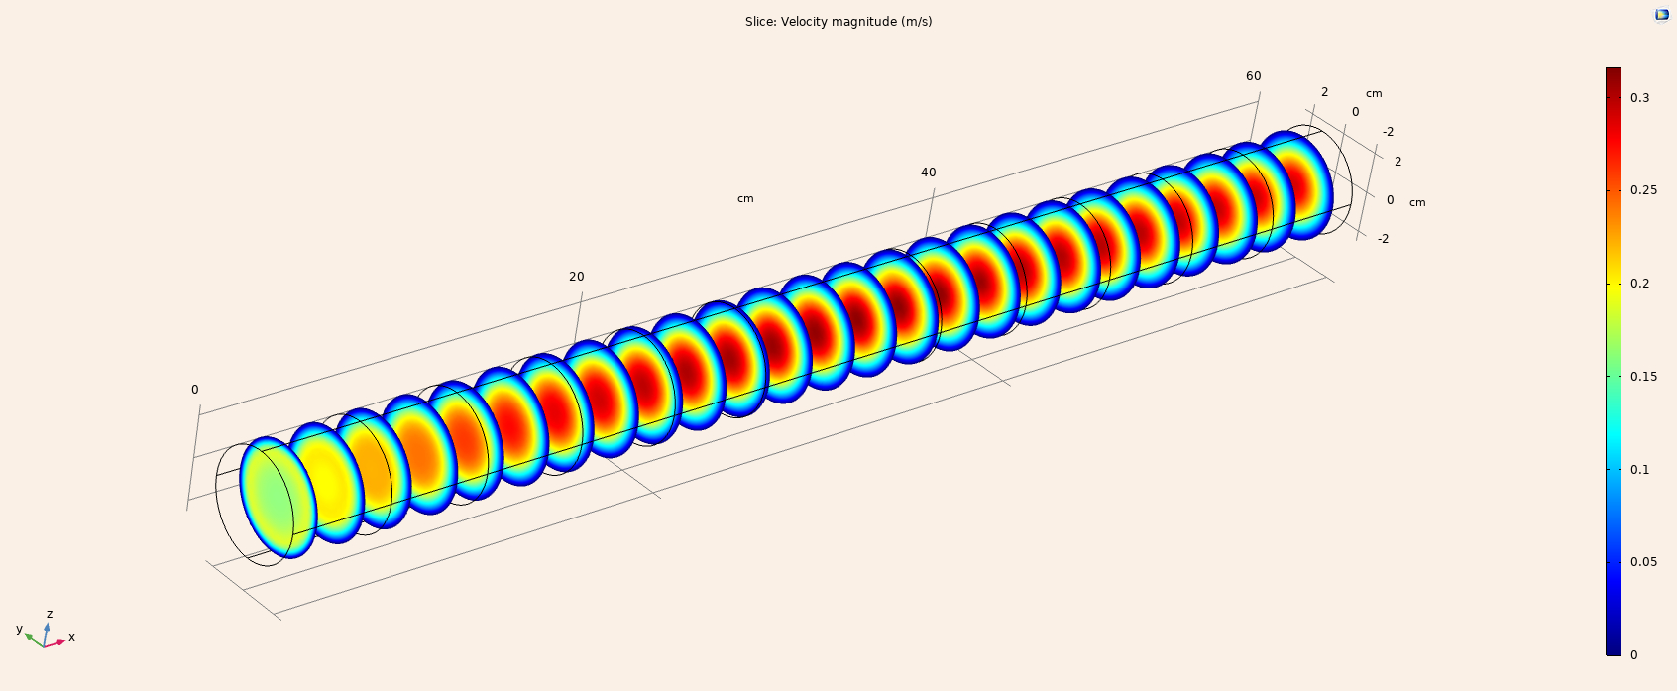
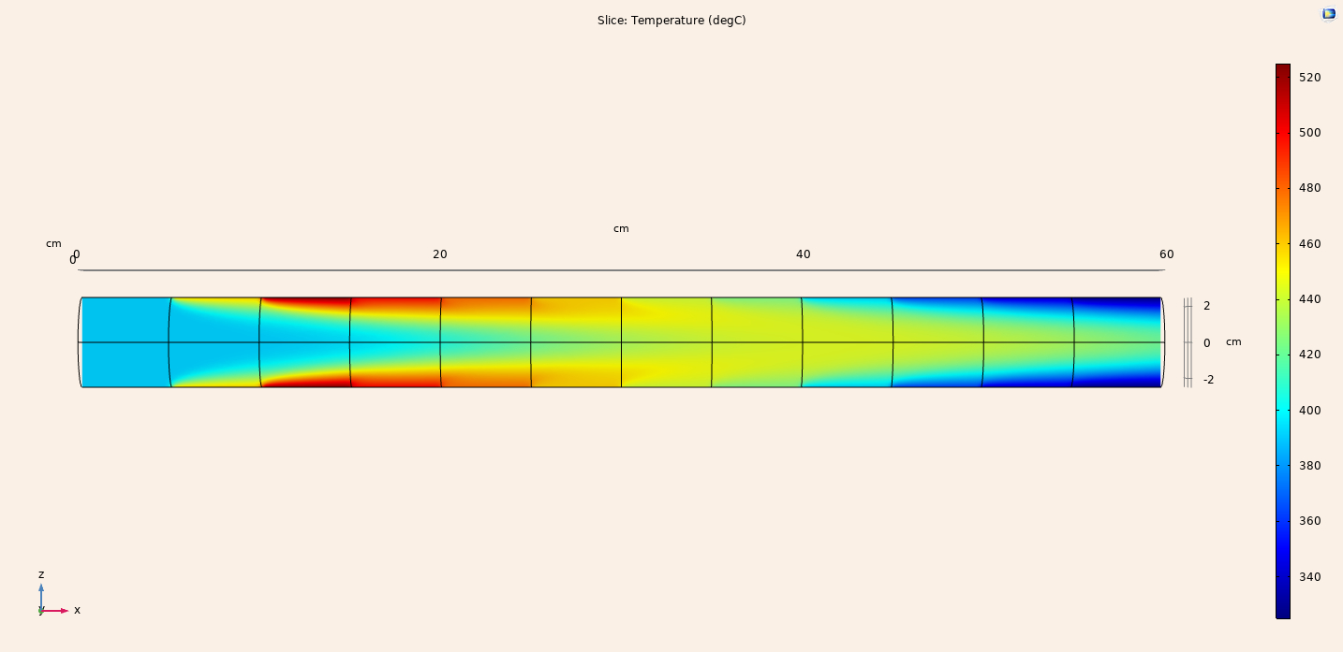
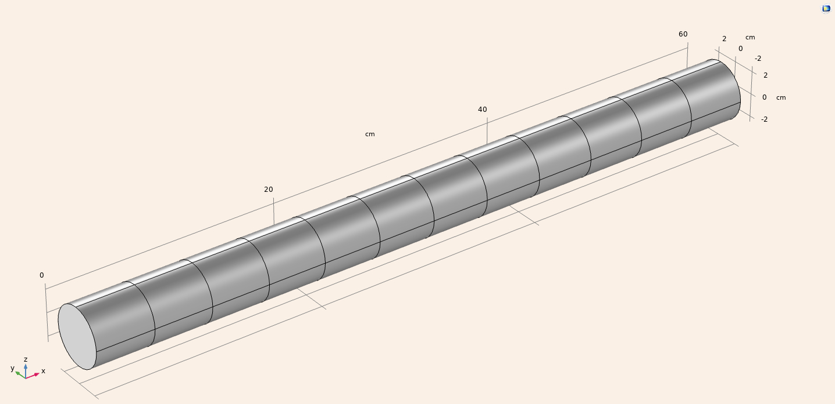
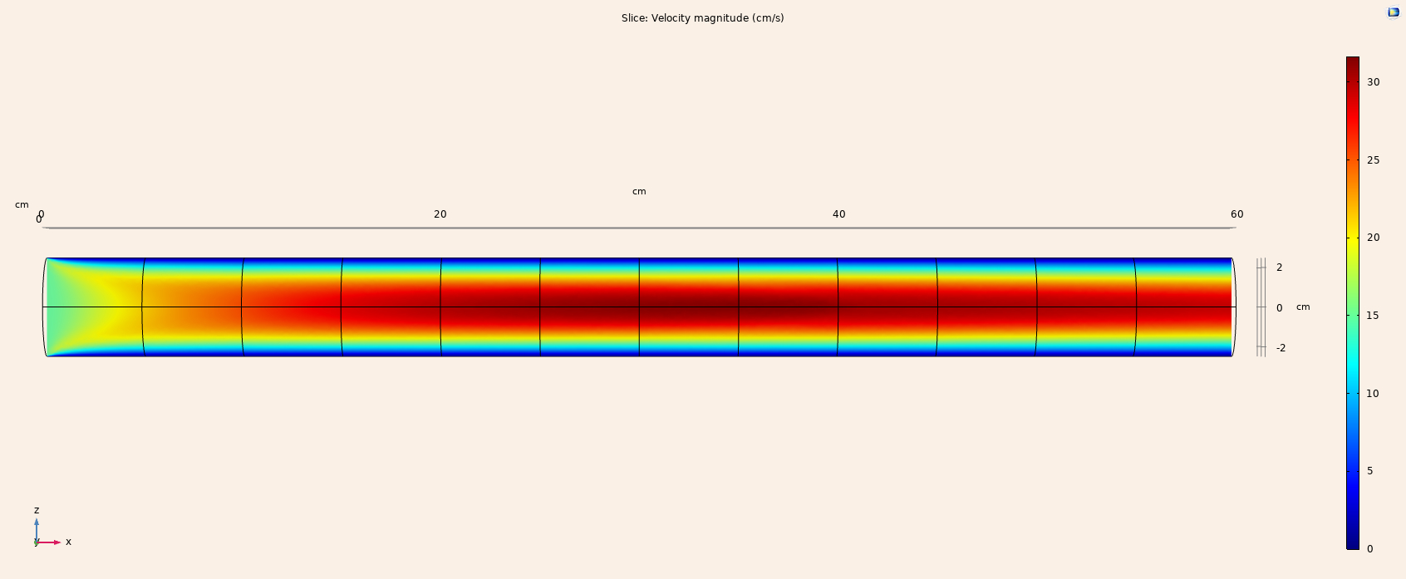
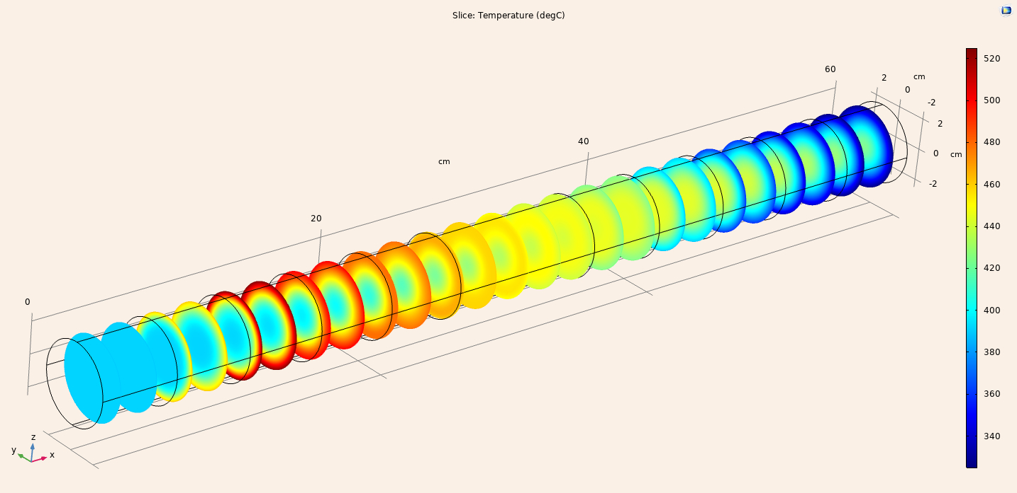
COMSOL SIMULATION
Velocity profile
Temperature profile
Geometry
U₀ = 15 cm/s
P₀ = 0 Pa
Defined boundary walls
U = 0 cm/s
T₀ = t_{n} … n = 1 to 12

Slide 21
CONCLUSION
Synthesized ZnO nanorods using various concentrations of KMnO₄ additive.
With increase conc. of KMnO₄ increase in diameter of nanorods and lower shift in bandgap energy is observed.
With increase in AgNO₃:Ethanol conc. the Ag NPs density and growth rate increases also on larger diameter nanorods growth rate and hence density is higher.
For increasing conc. of AgNO₃:Ethanol the resonant wavelength is observed to have a higher shift.
Temperature variation profile due to the gas flow in PVT tube is studied in COMSOL.

Slide 22
PLAN OF ACTION
Work | Sem1 |  | Sem2 |  | Sem3 |  | Sem4
 | Q1 | Q2 | Q3 | Q4 | Q5 | Q6 | Q7 | Q8
Experimental training and literature review about proposed topic
Simulation
Fabrication experiments
Device fabrication and optimization
Paper Writing
Thesis Writing

Slide 23
ACKNOWLEDGEMENTS
My sincere thanks to:
My thesis supervisor “Dr. Vipul Singh” for his help and guidance.
I would like to extend my gratitude to my PSPC members, Dr. Eswara Prasad Korimilli and Dr. Swaminathan Ramabadran.
I am grateful to IIT Indore for providing the necessary resources for research.
I would also like to thank my team and colleagues for technical discussions.
I am thankful towards MHRD for providing for teaching assistantship.

Slide 24
REFERENCES
[1] Shan, T., Hou, X., Yin, X. et al. Organic photodiodes: device engineering and applications. Front. Optoelectron. 15, 49 (2022)
[2] Zhuge, Fuwei, et al. "Nanostructured materials and architectures for advanced infrared photodetection." Advanced Materials Technologies 2.8 (2017): 1700005.
[3] Phillips, J., et al. "Electronic and optoelectronic devices based on semiconducting zinc oxide." (2011): 101-127.
[4] M. R. Shenoy [NPTEL] “Semiconductor Optoelectronics, IIT Delhi” (Part IV-4)
[5] Xu, Hua, et al. "High responsivity and gate tunable graphene‐MoS2 hybrid phototransistor." Small 10.11 (2014): 2300-2306.
[6] Parasuraman S. [NPTEL] “Fundamentals of electronic materials and devices, IIT Madras”(Week 7.4)
[7] Plakhotnyuk, Maksym. "Nanostructured Heterojunction Crystalline Silicon Solar Cells with Transition Metal Oxide Carrier Selective Contacts." (2018).
[8] Zhang, Xiaoqiang, et al. "All-organic flexible heterojunction thin film photodetectors based on phthalocyanines/C60." AIP Advances 12.8 (2022).

Slide 25
REFERENCES
[9] Rana, Amit Kumar, et al. "Transparent Co3O4/ZnO photovoltaic broadband photodetector." Materials Science in Semiconductor Processing 117 (2020): 105192.
[10] Agrawal Jitesh, et al. "ZnO/Pt/P3HT hetero-junction configuration for high performance Self-biased UV Detection." IEEE Electron Device Letters (2023).
[11] Ren, H., Chen, J.-D., Li, Y.-Q., Tang, J.-X., Recent Progress in Organic Photodetectors and their Applications. Adv. Sci. 2021, 8, 2002418. https://doi.org/10.1002/advs.202002418
[12] Reese, Colin, and Zhenan Bao. "Organic single-crystal field-effect transistors." Materials Today 10.3 (2007): 20-27.
[13] Zhao, Xiaotong, et al. "Organic Semiconductor Single Crystal Arrays: Preparation and Applications." Advanced Science (2023): 2300483.
[14] Laudise, R. A., et al. "Physical vapor growth of organic semiconductors." Journal of crystal growth 187.3-4 (1998): 449-454.
[15] Zhang, Yifan, et al. "Radiation induced plasmonic nanobubbles: fundamentals, applications and prospects." AIMS Energy 9.4 (2021): 676-713.

Slide 26
THANK YOU !

